Slide 1
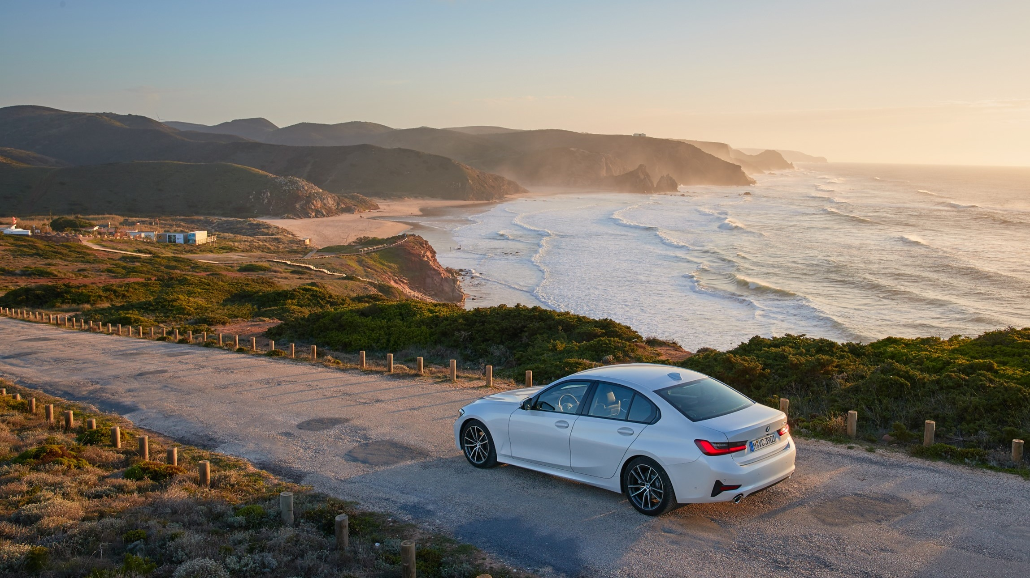

Real Time Emotion Recognition for Embedded Devices
Nikan Moghadam
Technical University of Munich
Department TUM Department of Informatics
Chair Robotics, Artificial Intelligence and Real-time Systems
Supervision Prof. Dr.-Ing. Alois Knoll
M.Sc. Sina Shafaei
Research Project OSBORNE
Date Munich, 22.08.2019

Slide 2
Presentation Overview
b
Research Area
Comparison & Benchmark
Conclusion
Methodology
Proposed System
Components
Face Detector
Object Tracker
Emotion Classifier
Notes:
First of all structure of the presentation
Research Area and focus
Methodology and how research & Benchmarking was conducted
Benchmark & Comparison Results
Finally the proposed system is introduced with a short demo
And concluded
All components covered (face detector, object tracker and emotion classifier)

Slide 3
Haar Cascade
Convolutional Neural Network
Viola Jones Algorithm
KCF Object Tracker
Histogram of Oriented Gradients
Landmark Classifier
CSRT Object Tracker
Haar Cascade
Decision Tree
Face Detection
MOSSE Object Tracker
Object Tracking
Histogram of Oriented Gradients
Neural Network
Emotion Classification
TLD Object Tracker
Convolutional Neural Network
Support Vector Machine
No Object Tracking
Decision Tree
KCF Object Tracker
Neural Network
MOSSE Object Tracker
Notes:
Task:
Implement computer vision based Emotion Recognizer for vehicles that is able to recognize up to 4 faces in real time
CONCRETE SYSTEM: Raspberry PI 3 (MAIN CHALLENGE)
Assumptions regarding Scenario:
A camera mounted inside vehicle and we assumed dynamic lighting conditions and little movement of the faces
THREE COMPONENTS
Detect Faces
Handle Movement
Classify Emotions
-> MOST IMPORTANTLY FIND right combo

Slide 4
KCF Object Tracker
Haar Cascade
CSRT Object Tracker
Landmark Classifier
Convolutional Neural Network
MOSSE Object Tracker
Decision Tree
Viola Jones Algorithm
TLD Object Tracker
Neural Network
Face Detection
Histogram of Oriented Gradients
Histogram of Oriented Gradients
No Object Tracking
Support Vector Machine
No Object Tracking
Support Vector Machine
Object Tracking
Emotion Classification
Haar Cascade
KCF Object Tracker
Decision Tree
Histogram of Oriented Gradients
MOSSE Object Tracker
Neural Network
Convolutional Neural Network

Slide 5
KCF Object Tracker
CSRT Object Tracker
MOSSE Object Tracker
Landmark Classifier
TLD Object Tracker
Decision Tree
Haar Cascade
No Object Tracking
Neural Network
ASP.NET
Face Detection
KCF Object Tracker
Support Vector Machine
Convolutional Neural Network
KCF Object Tracker
Support Vector Machine
Convolutional Neural Network
Object Tracking
Emotion Classification
Viola Jones Algorithm
MOSSE Object Tracker
Decision Tree
Histogram of Oriented Gradients
Neural Network
Visual Studio
Haar Cascade
Histogram of Oriented Gradients
Convolutional Neural Network
Notes:
Multiple approaches were combined and tested until final result

Slide 6
Research Areas
Face Detection
Object Tracking
Emotion Classification
Notes:
What I did:
Isolate into three subsystems and assess seperately

Slide 7
Research Areas
Face Detection
Object Tracking
Notes:
And since there was existing emotion classifier
BOTTLENECK was FD and OT -> They became scope of thesis

Slide 8
Methodology
How Benchmarking was performed
Notes:
Before we start with a deep dive into the benchmark results
AS THERE IS NO PAPER COMPARING THESE IMPLEMENTATIONS ON A PI
HAD TO DO OWN BENCHMARKS
IN ORDER TO FIND BEST COMPONENTS FOR FINAL IMPLEMENTATION subcomponents were benchmarked seperately
One performance BM focussing on speed of system
One qualitative assessment focussing on accuracy & detection capabilities

Slide 9
Performance Benchmark
Performed on live video stream
Standardized Testing:
Start with one face at 0.5m
Add second face after 15 sec
Metrics:
Median FPS
Average FPS
FPS Variance
Notes:
Performance benchmark on Raspberry PI Version 3 B+ with Raspberry PI camera V2.1. RESOLUTIONS were set so that distance up to 1.8 meter (assumed max distance inside a car)
live feed of the camera , not prerecorded video, for that additional benchmark decided to separate
Why? -> Decoding compressed video, get as realistic numbers as possible
Standardized and comparable benchmark
Start: 1 face at 0.5 m -> Object Tracker speed depends on tracked area
15 sec: 2nd face -> Measure performance impact of multiple faces [for 5 sec, overall 1 min test duration]
WITHOUT Landmark classifier -> More isolated results
Model at bottom: Live measurements saved to sql database, data then analyzed in Power bi
(Time of measurement, processing time per frame, method, platform, measurement id and number of faces detected per frame. The SQLite database was then connected to Power BI to perform further analysis and evaluate the results.)

Slide 10
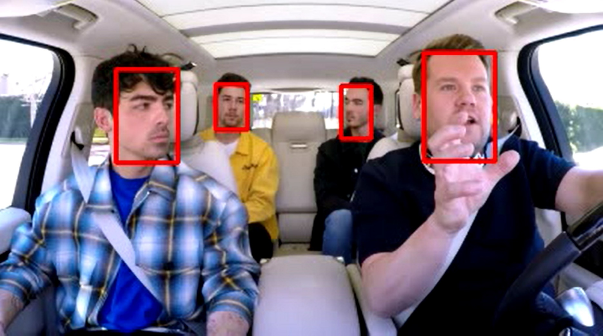
Qualitative Benchmark
Performed with 2-minute video representing our use case
Metric:
Sum of detected faces over all frames
Additionally:
Qualitative assessment with live feed
Jonas Brothers Carpool Karaoke with face detection rectangles
Notes:
2 BENCHMARK METHODS
informal qualitative assessment was performed to assess false positive rate, head tilt detection, handling of occlusion
With live video, NOTES, get a feeling
QUANTITATIVE
A clip from Carpool Karaoke with james cordon was used for the qualitative benchmark
It’s a 2 Minute recording of 4 people in a car in Los Angeles [2:09]
All faces are well lit however the faces are sometimes tilted and there is occlusion (hand, seats etc.)
Key Performance Metric: Sum of the detected faces in every frame

Slide 11
Face Detection – Performance
Resolution adapted to enable detections up to 1.8m
Our CNN offers almost 2x speedup vs. OpenCV CNN
KCF boosts average performance but also increases variance as face detection results in frame drops
Notes:
Comparison: In order to have valid results the resolution was modified to enable similar capabilities for all approaches
Requirement was to enable a detection up to 1.8 meteres -> Assumed max distance inside a car
HoG needs higher resolution than CNN -> Negative performance impact
Standardization: All alforithms optimized so that they can detect faces in the backseat of benchmark video
Optimize range through resolution
Arguments!

Slide 12
Face Detection – Quality
OpenCV CNN used as reference point
Viola Jones Algorithm fails at detecting even slightly tilted faces
CNNs offer highest accuracy
Notes:
Detected faces relative to OpenCV CNN
-> Video almost 4000 frames that I couldn’t annotate manually
100% of OpenCV set as reference point
CNNs are leading, Viola Jones fastest but very low detection rate
Notes qualitative benchmark I performed on live video
Viola Jones Problem detecting tilted faces

Slide 13
Object Tracker Comparison
KCF
MOSSE
15 FPS for one face
2-3 FPS performance reduction per additional face
Performance depends on covered area
40 FPS for one faces
5 FPS performance reduction per additional face
Fastest tracker in OpenCV
More tracking errors compared to KCF (detection loss)
Notes:
Two algorithms
KCF and MOSSE
MOSSE much faster
However -> Tracking Loss Much Higher
PROBLEM: THE MORE FACES THE Higher tracking failures (linear) -> Costly face detection retriggered
Impact per additional face 2-3 & 5 FPS
KCF highly dependent on covered area -> 0.5 m -> face very close -> 6-7 FPS

Slide 14
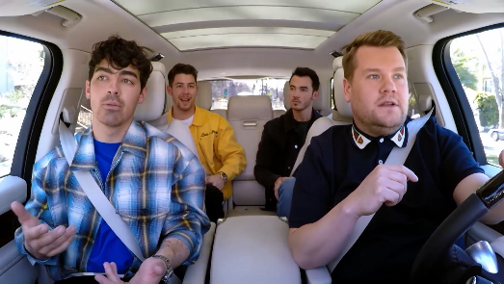
Proposed System
Video pipeline
Analytics
Video stream
SQLite Database
Power BI
Report
Emotion Recognition System
PI Camera
Face Detector
Object Tracker
Emotion Classifier
Detections
Notes:
Starts with video pipeline
Resize 400x224
TWO COMPONENTS
ERS and Analytics framework
SAY WHAT THEY CONTAIN
EXPLAIN DETAILS IN FOLLOWING SLIDES

Slide 15


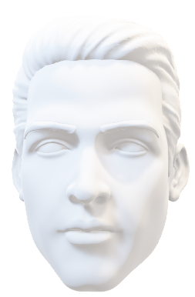
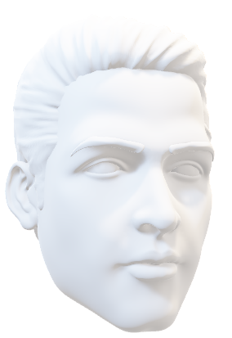

Notes:
Let’s walk through every step of the process together
Video Steam
Task detect faces, AND UNDERSTAND MIMIC etc.

Slide 16
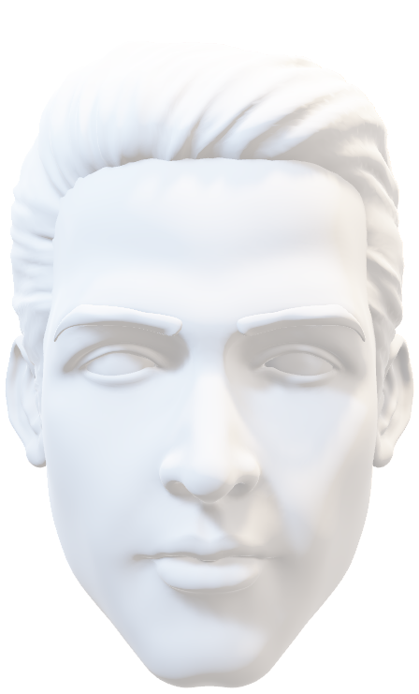
Face Detection
Returns bounding boxes for each face
Face Detector based on MobileNetV2 SSDLite architecture (CNN)
Model was trained on Wider Face data set
Contains 393.000 faces
Training set reduced to 30.000 high resolution faces
71% faster than OpenCV pretrained CNN
9% detection loss compared to OpenCV pretrained CNN
Notes:
FIRST Face Detection with bounding boxes
The FD we used is a CNN based on MobileNetV2 architecture
-> Optimized for mobile devices, fast
Trained on Wider Face datset, faces 393k -> <16px removed
30k train, 7700 test images (80/20 Split) 31000 iterations
MODEL IS 71% faster than OpenCV CNN
9% less faces in benchmarking video

Slide 17
Motion Tracking
KCF algorithm tracks detected faces
Face Detection triggered automatically
Either every 10 seconds
When KCF fails or looses track
When no face is tracked
Tracking speed 10-15 FPS
Problem: Bounding box not scaled with face distance (see future work)
Notes:
NOT RUN FD all the time:
Because for our scenario, low movement object tracker could do same job
FD is triggered when face is lost or no face is tracked
KCF
Slower than MOSSE but tracking errors are very costly
Problem: Scaling does not work -> face moves closer

Slide 18
Emotion Classification
Dlib facial landmark detector is used to extract 68 facial landmarks
Detected landmarks classified by SVM trained on CK+ dataset
Classification into 7 different emotions
50 ms detection time per face
Notes:
Existing implementation used as cost per face 50 ms
First dlib landmark detector is used
Then emotions are classified with SVM trained on CK+ dataset in scikit learn

Slide 19
10.9
85%
Accuracy*
FPS
16x
Speedup vs OpenCV CNN
* As defined in slide 12
Notes:
Final results
10.9 FPS -> Same testing routine as everything else
Almost as accurate as OpenCV CNN -> 85% FOR OUR USE CASE
… but 16x faster!
Reference numbers

Slide 20
Conclusion
Advantages:
Combined approach enables significant speedup
Faster and more accurate than traditional approaches (Viola Jones, HoG)
Future Work:
Mechanism for scaling bounding boxes correctly
Optimize neural network architecture
Improve emotion classification
Notes:
Combined approach allows for significant speedup in our use case
Low movement faster and keeping accurate (for instance at night)
However tracking can be improved, bad performance when there is lots of movement
Future work -> scaling based on facial landmarks
Optimize neural network architecture as current model is based on general object detector

Slide 21
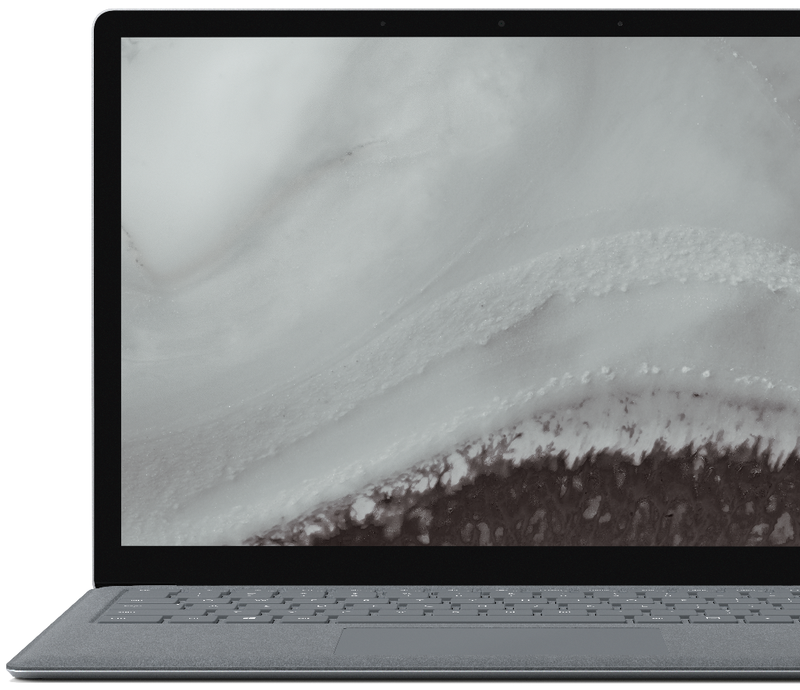

Demo
Notes:
Demo

Slide 22

Thank you.
1
Notes:
Thanks.

Slide 23
Sources
Icons:
List by unlimicon from the Noun Project
Video Camera by Phoenix group from the Noun Project
Computer Vision by Becris from the Noun Project
RBM by sachin modgekar from the Noun Project
Tracker by creative outlet from the Noun Project
3D models:
Microsoft (3D model library)
Images:
BMW
Microsoft
Jonas Brothers Carpool Karaoke from The late late show with James Cordon (https://www.youtube.com/watch?v=aDcTSYZu-zY)

Slide 24
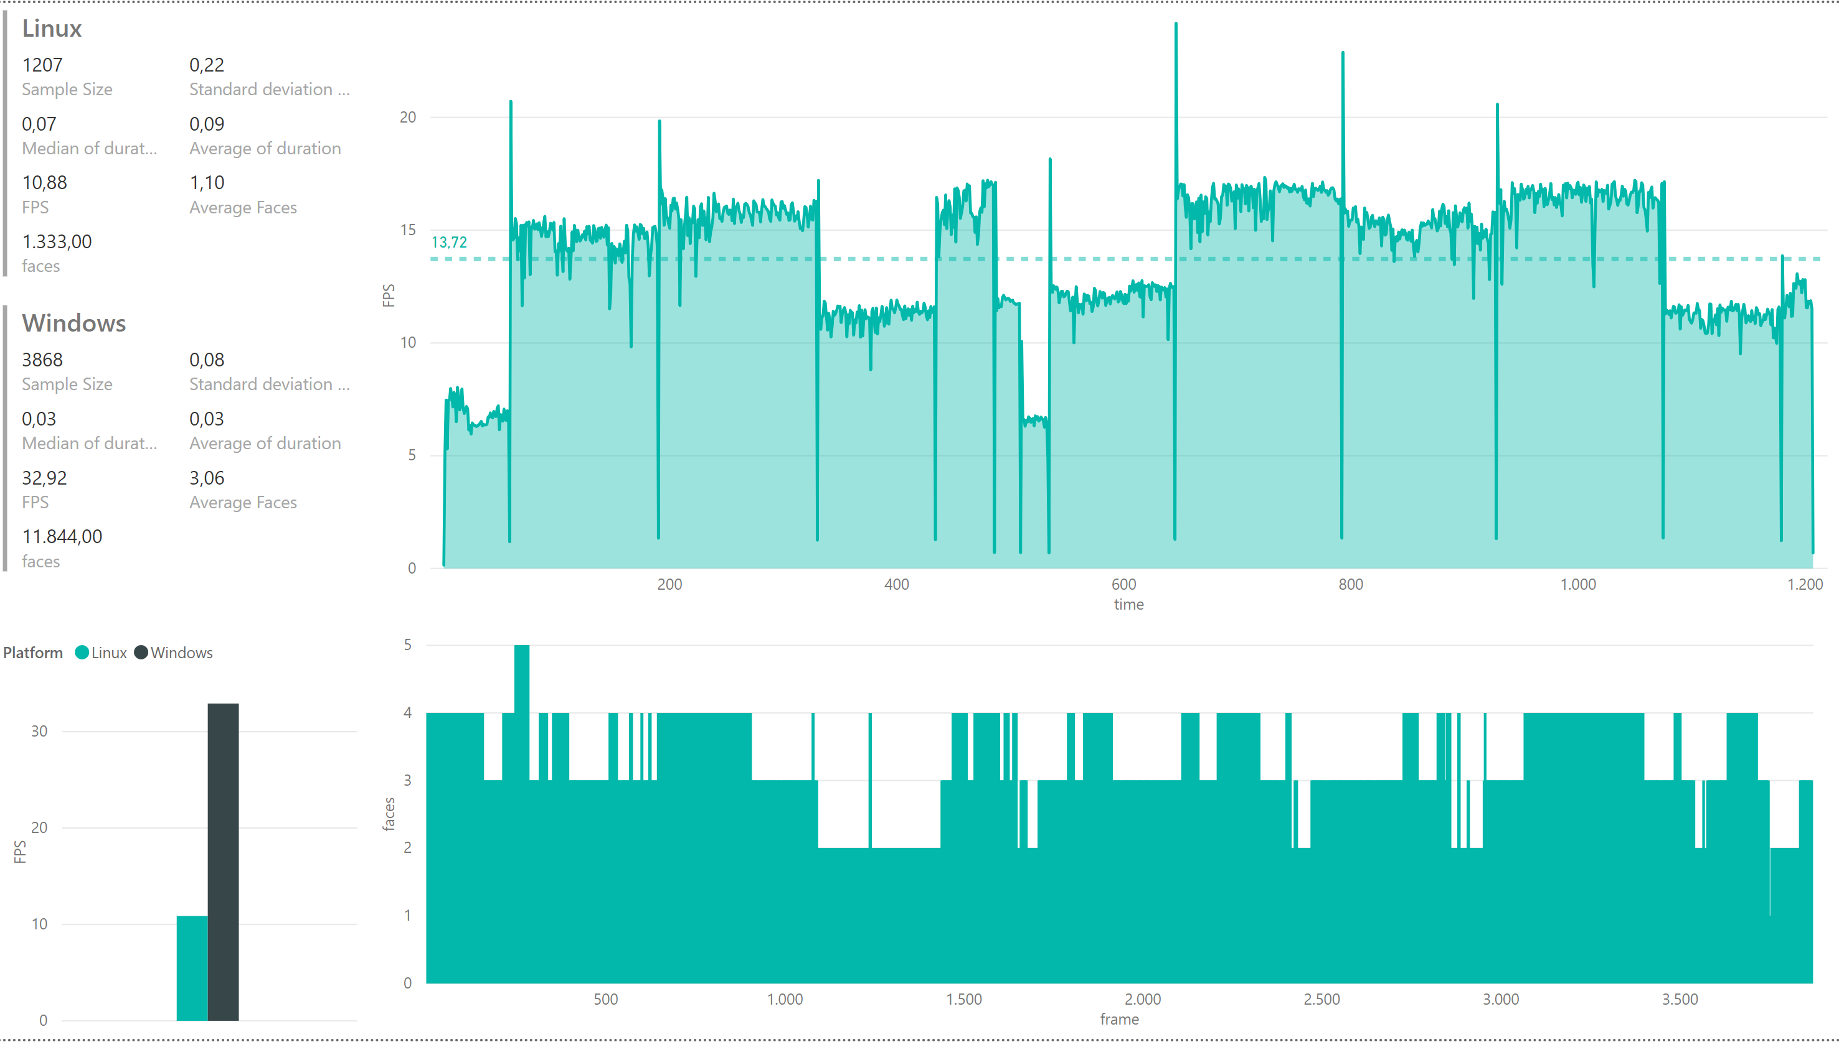
Proposed System Evaluation

